Slide 1
Social Organization
© R. KYES
Social Organization - a broad, all encompassing term that includes a variety of aspects of the social group including:
- group size
- group composition
- mating arrangements
- spacing among individuals
- social structure

Slide 2
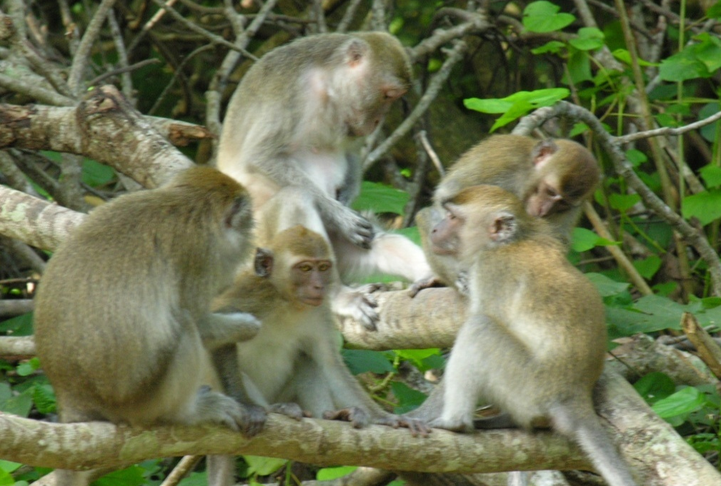
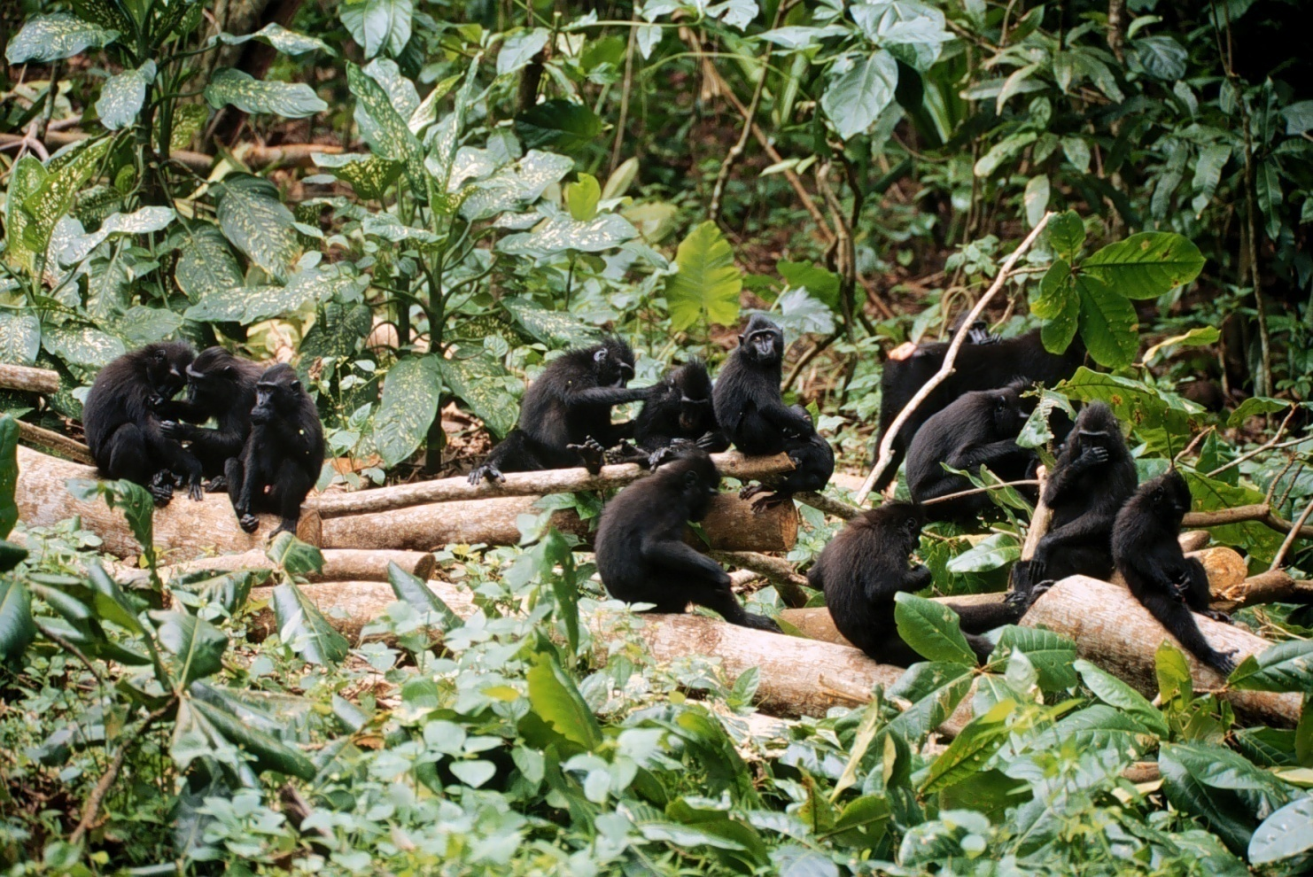
Social Structure - refers to the pattern of interactions & relationships among members of the group.

Slide 3
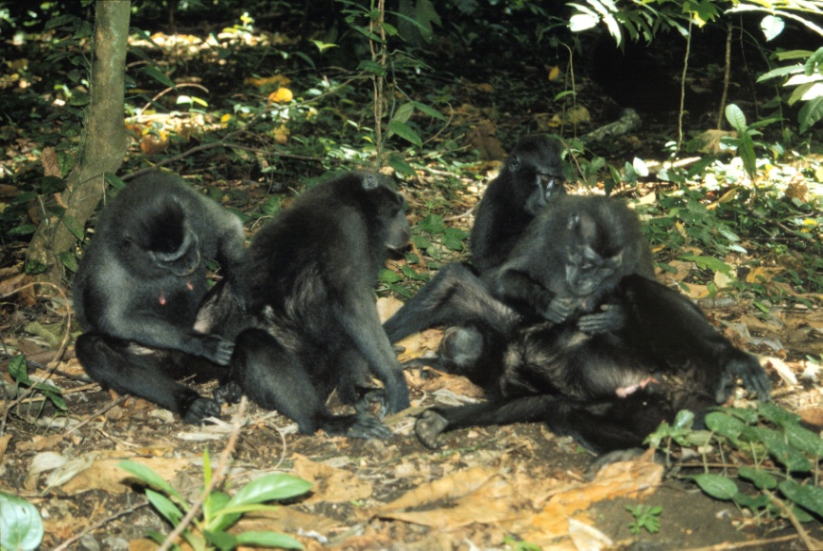
To study and understand social structure, we must study it at different levels (Robert Hinde).
1) Interactions - basic level of interaction between 2 animals.
grooms
A B
bites
A B

Slide 4
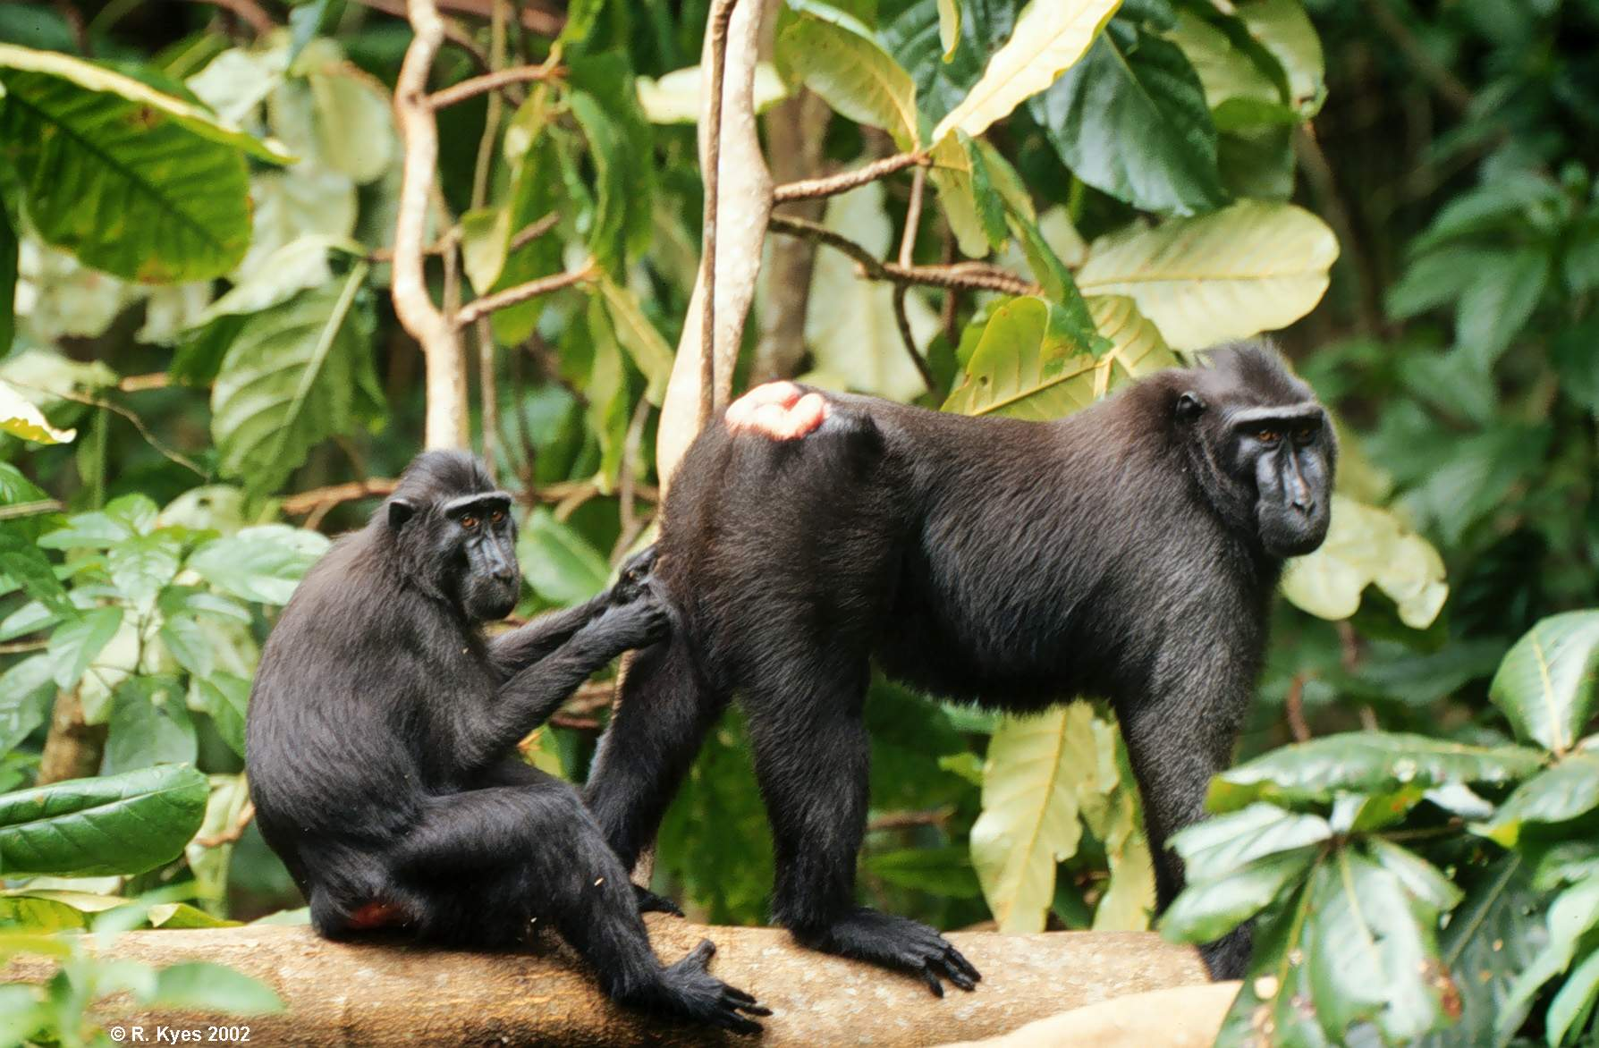
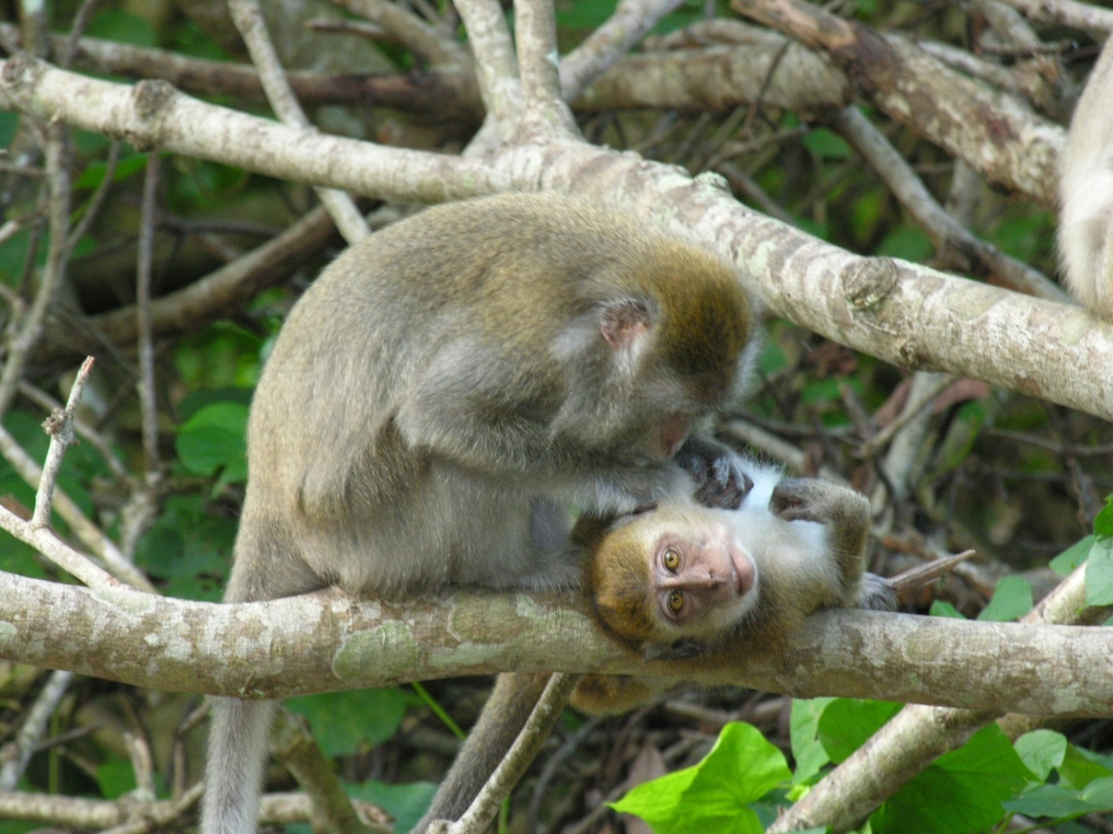
2) Relationships - intermediate level - a means of classifying the interactions between two animals.
Affiliative (friendly) relationship (grooming, sitting in prox, contact)

Slide 5
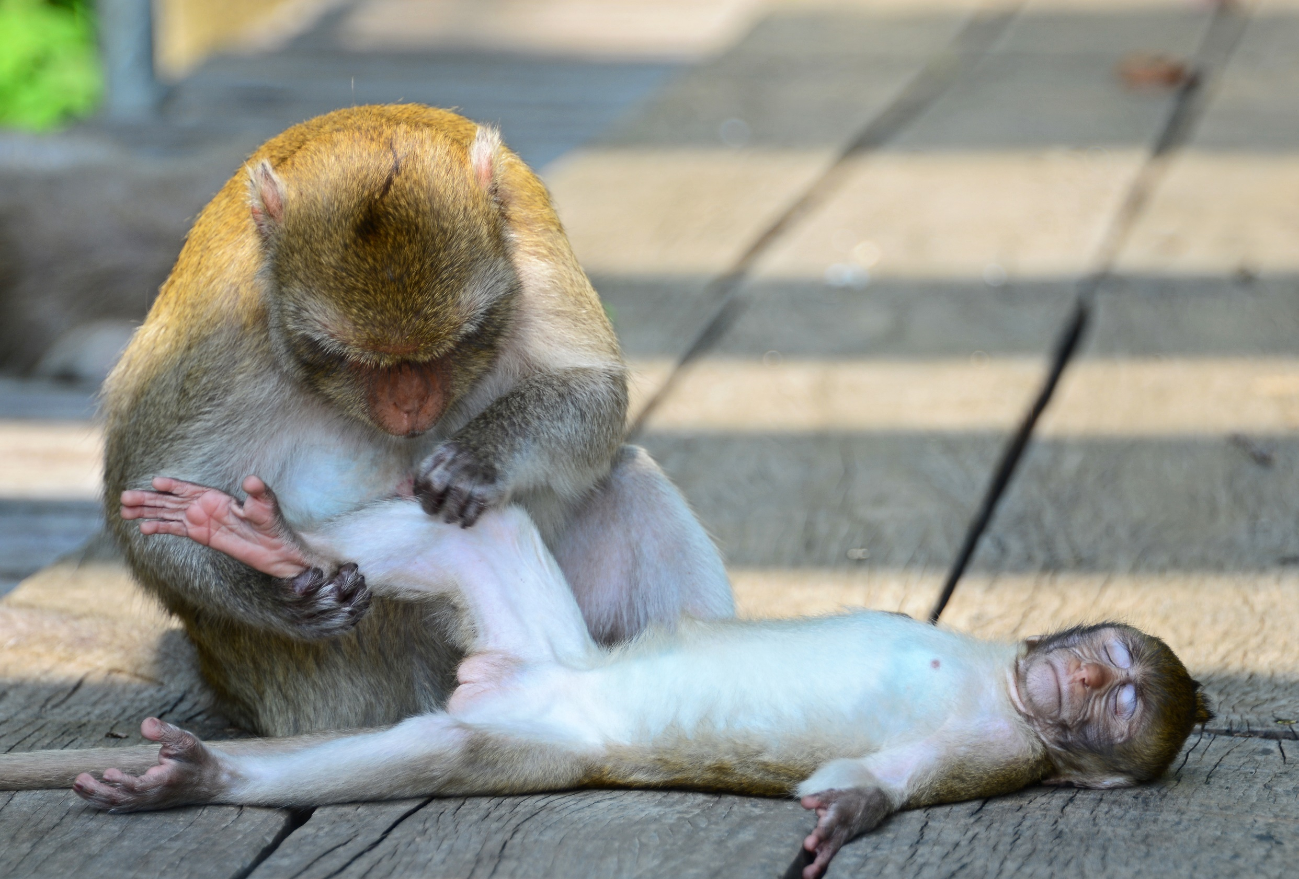

Slide 6
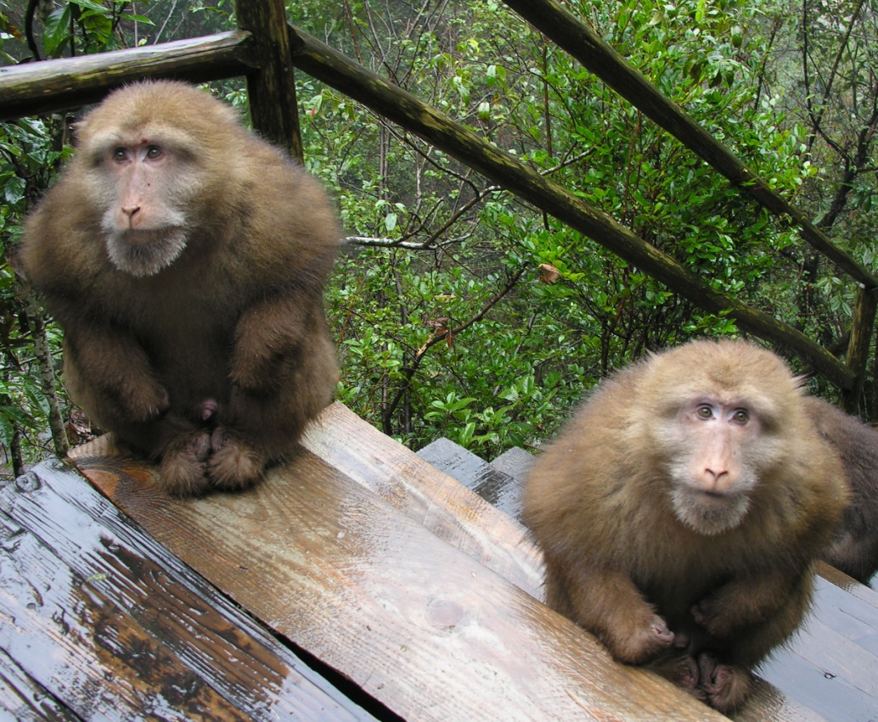

Slide 7
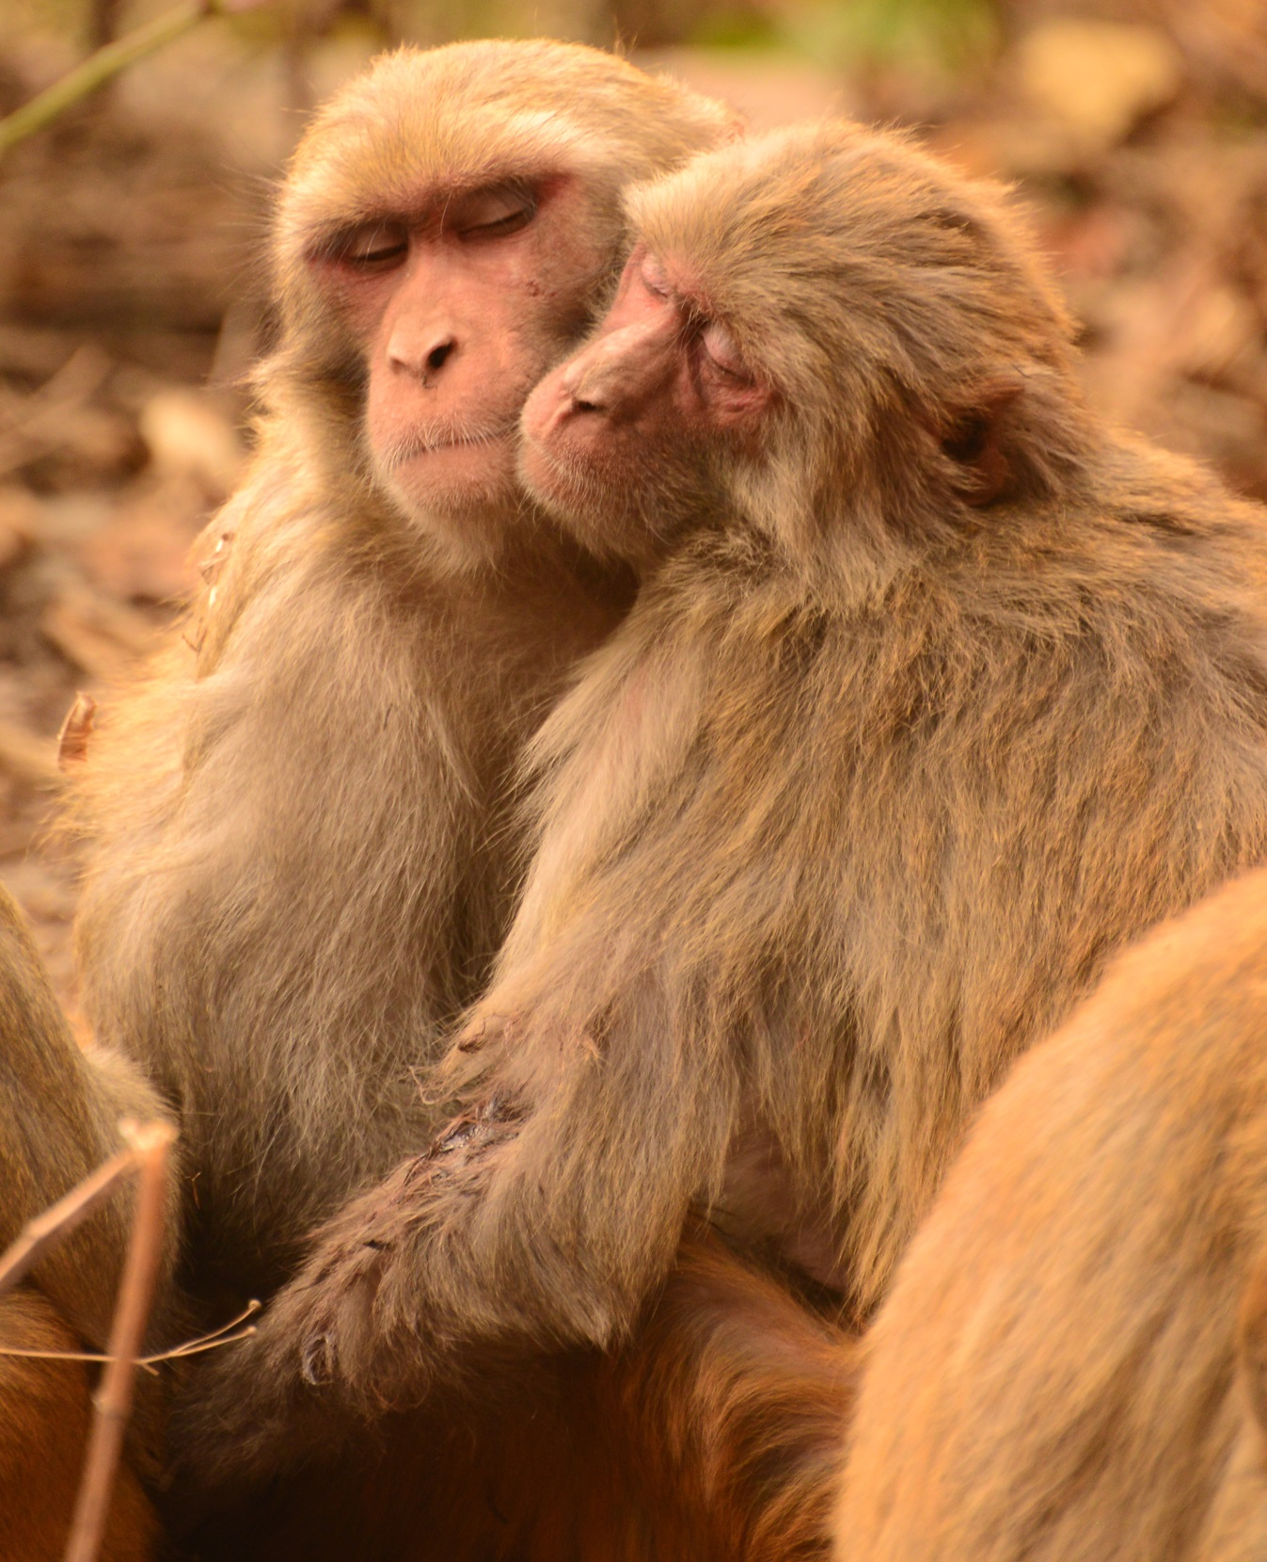

Slide 8
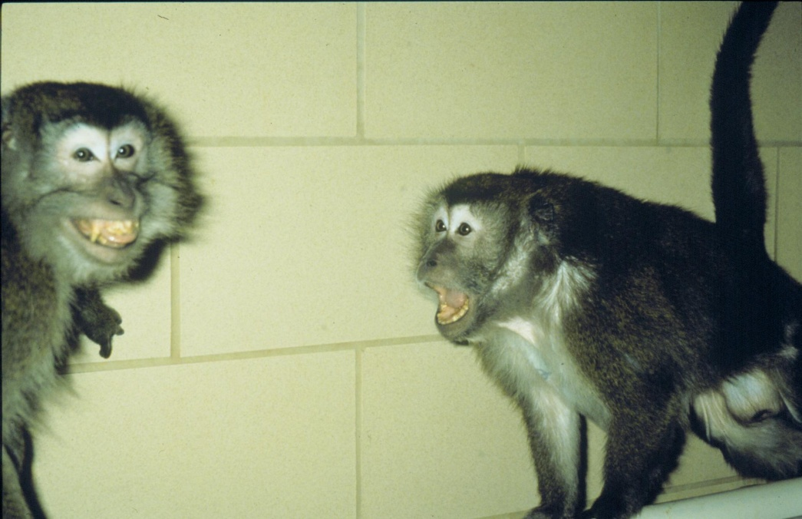
Agonistic (aggressive) relationship

Slide 9
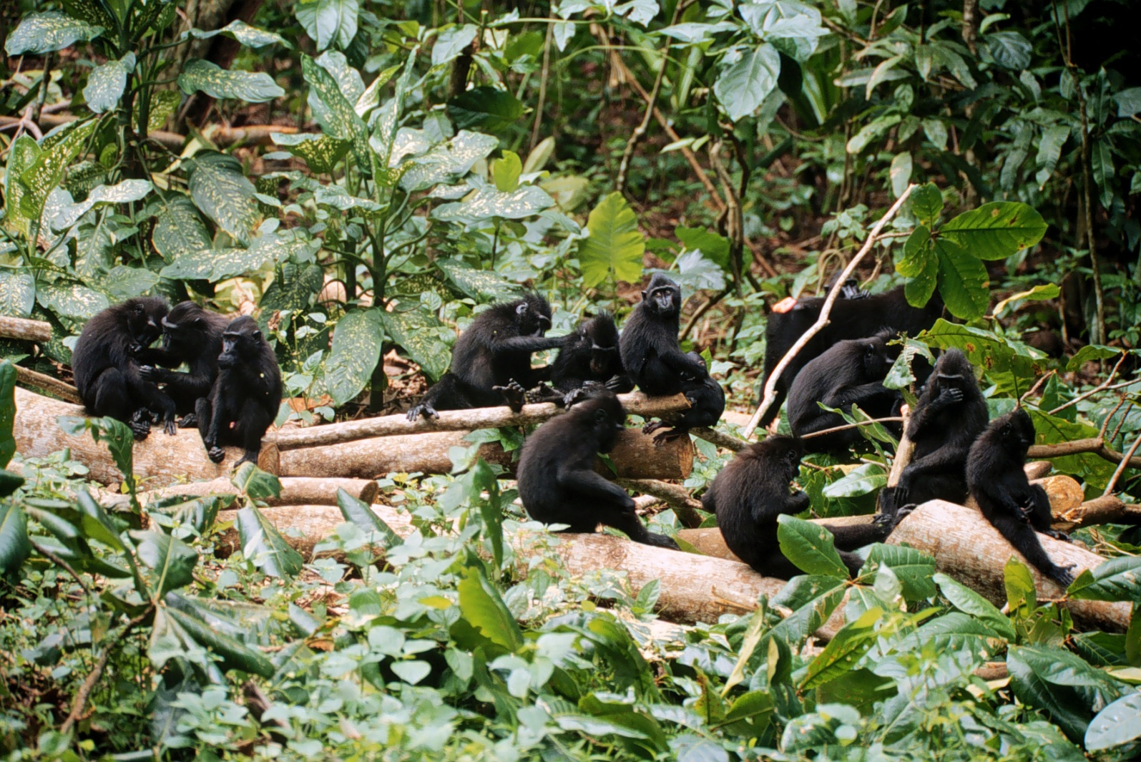
3) Social Structure - final level - describes all the types of relationships among individuals so as to understand the social structure of the group.

Slide 10
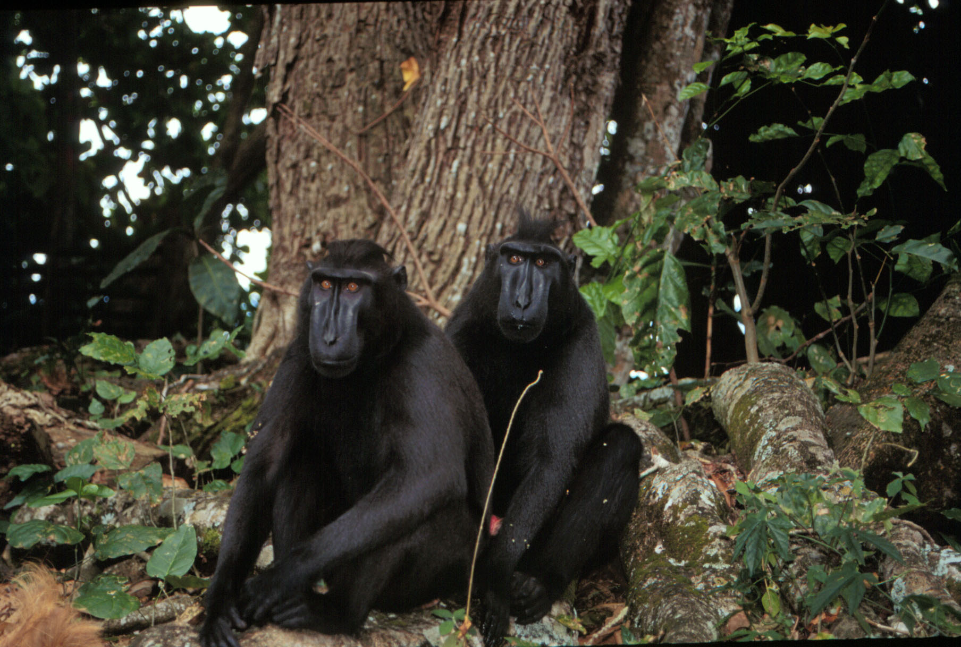
Dominance
There is one kind of relationship that seems to be important to the social structure of most primate groups and that is the Dominance Relationship.
Dominance Hierarchy (Social Status)

Slide 11
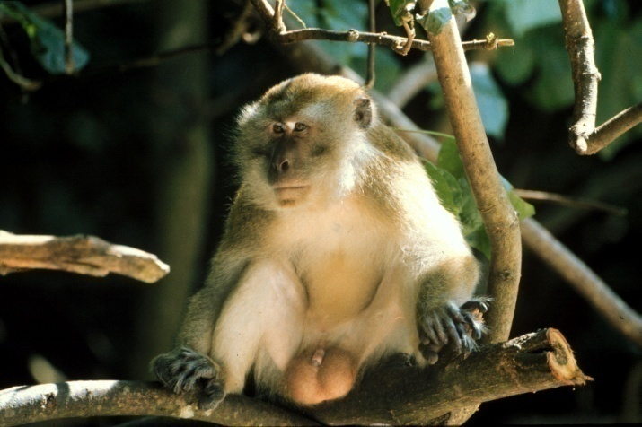
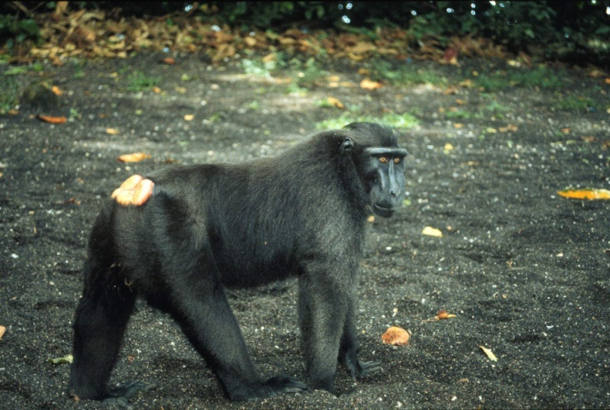
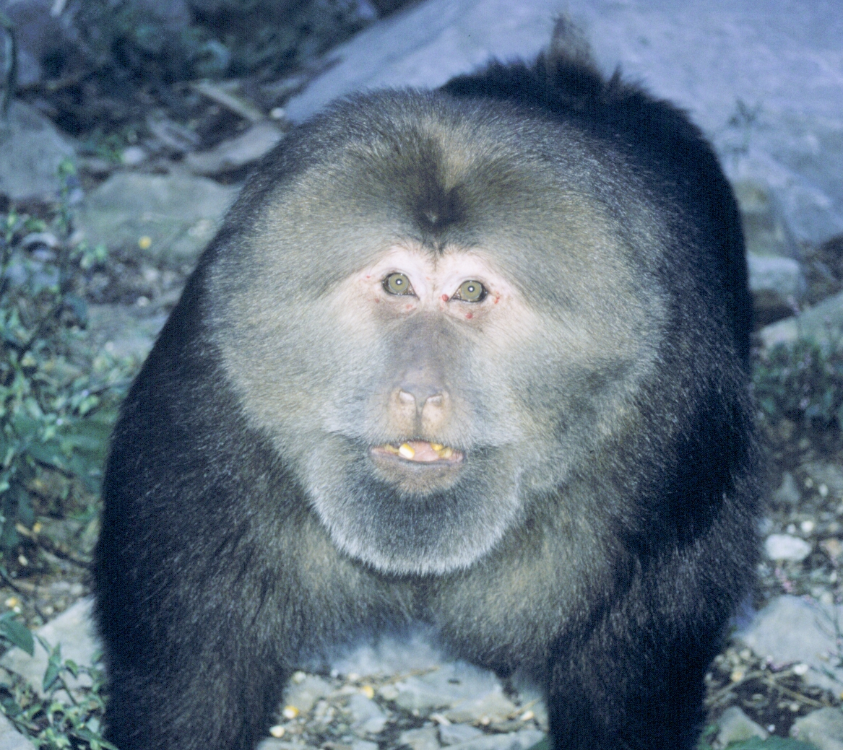
What is Dominance?
There have been a range of definitions: biggest, strongest, most aggressive, “the King,” etc.
- But dominance does not represent a measurable attribute of a single animal.
Dominance is a special relationship where one animal is able to consistently aggress against another with impunity (without retaliation).

Slide 12
How do we measure or determine Dominance?
1) Observe the direction of agonistic interactions
(aggression and submission) between two animals.
That is, we look for a winner and loser in a fight
or
a situation where one animal avoids another one.
Give example of direction of agonistic interaction

Slide 13
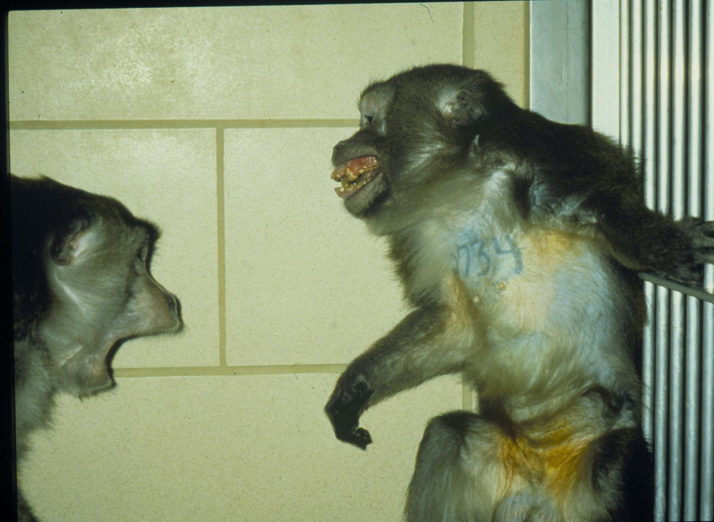
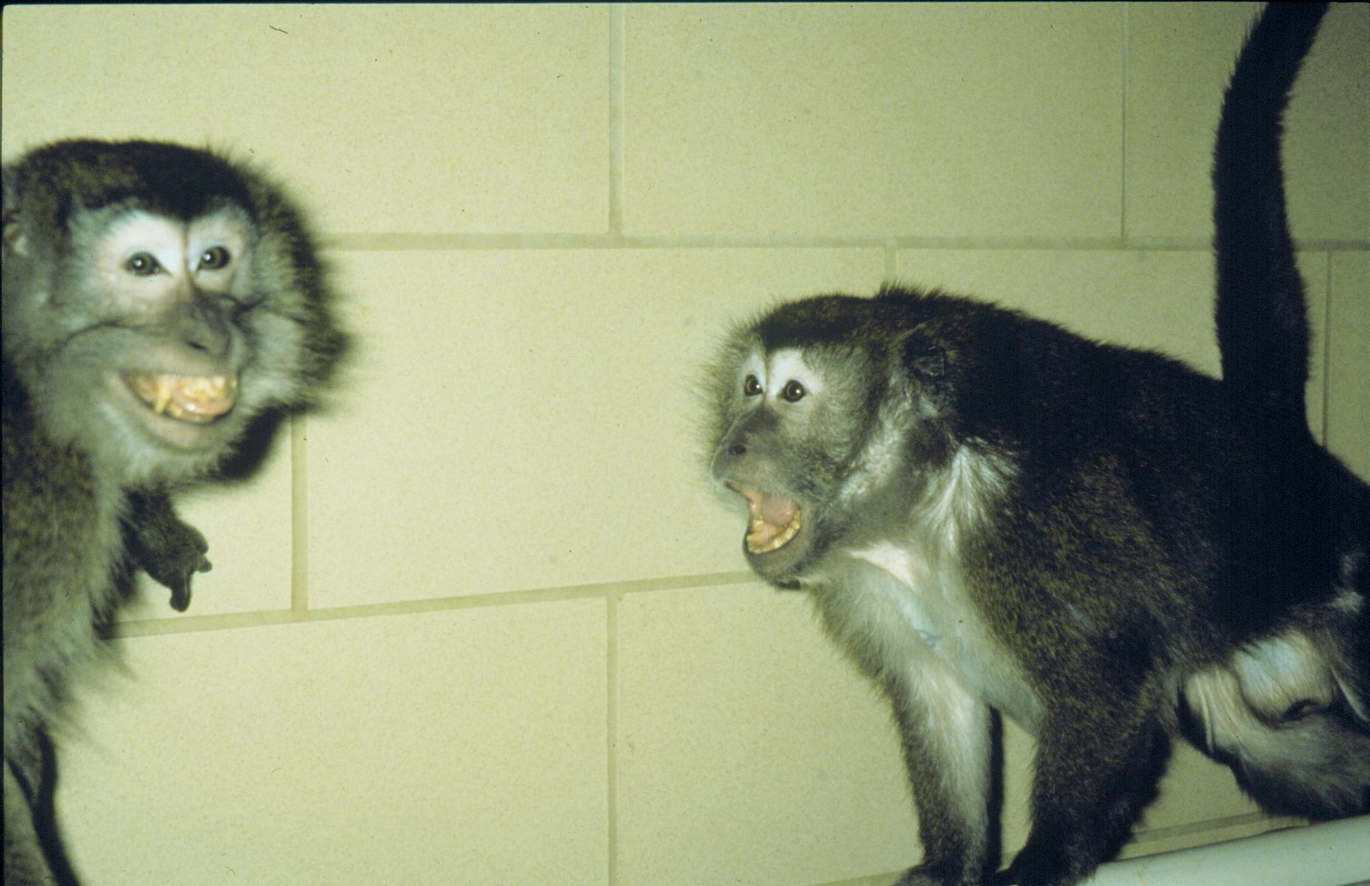
Submission
“Grimace”
Aggression
“Stare Threat”

Slide 14
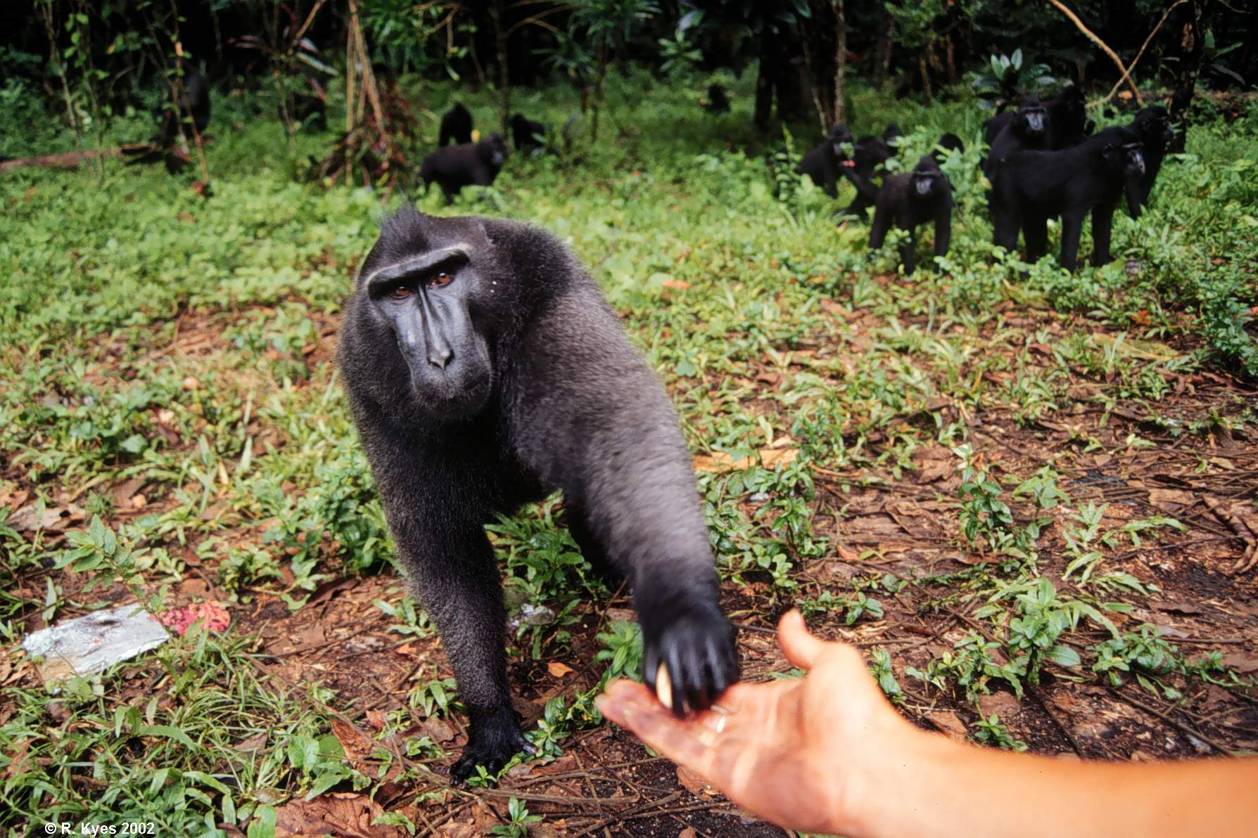
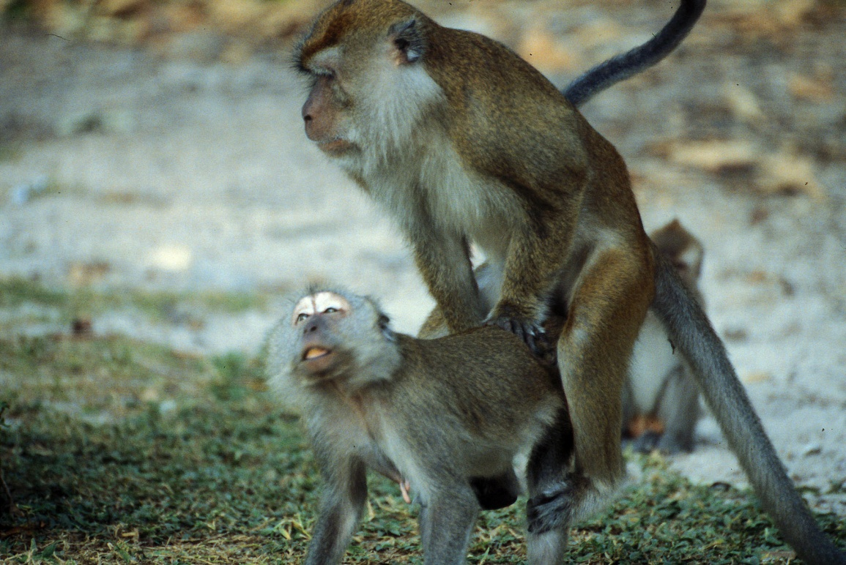
How do we measure or determine Dominance?
2) Observe the priority of access to limited resources
(i.e., food, sexual partners, etc.)
But, there are problems with this method

Slide 15
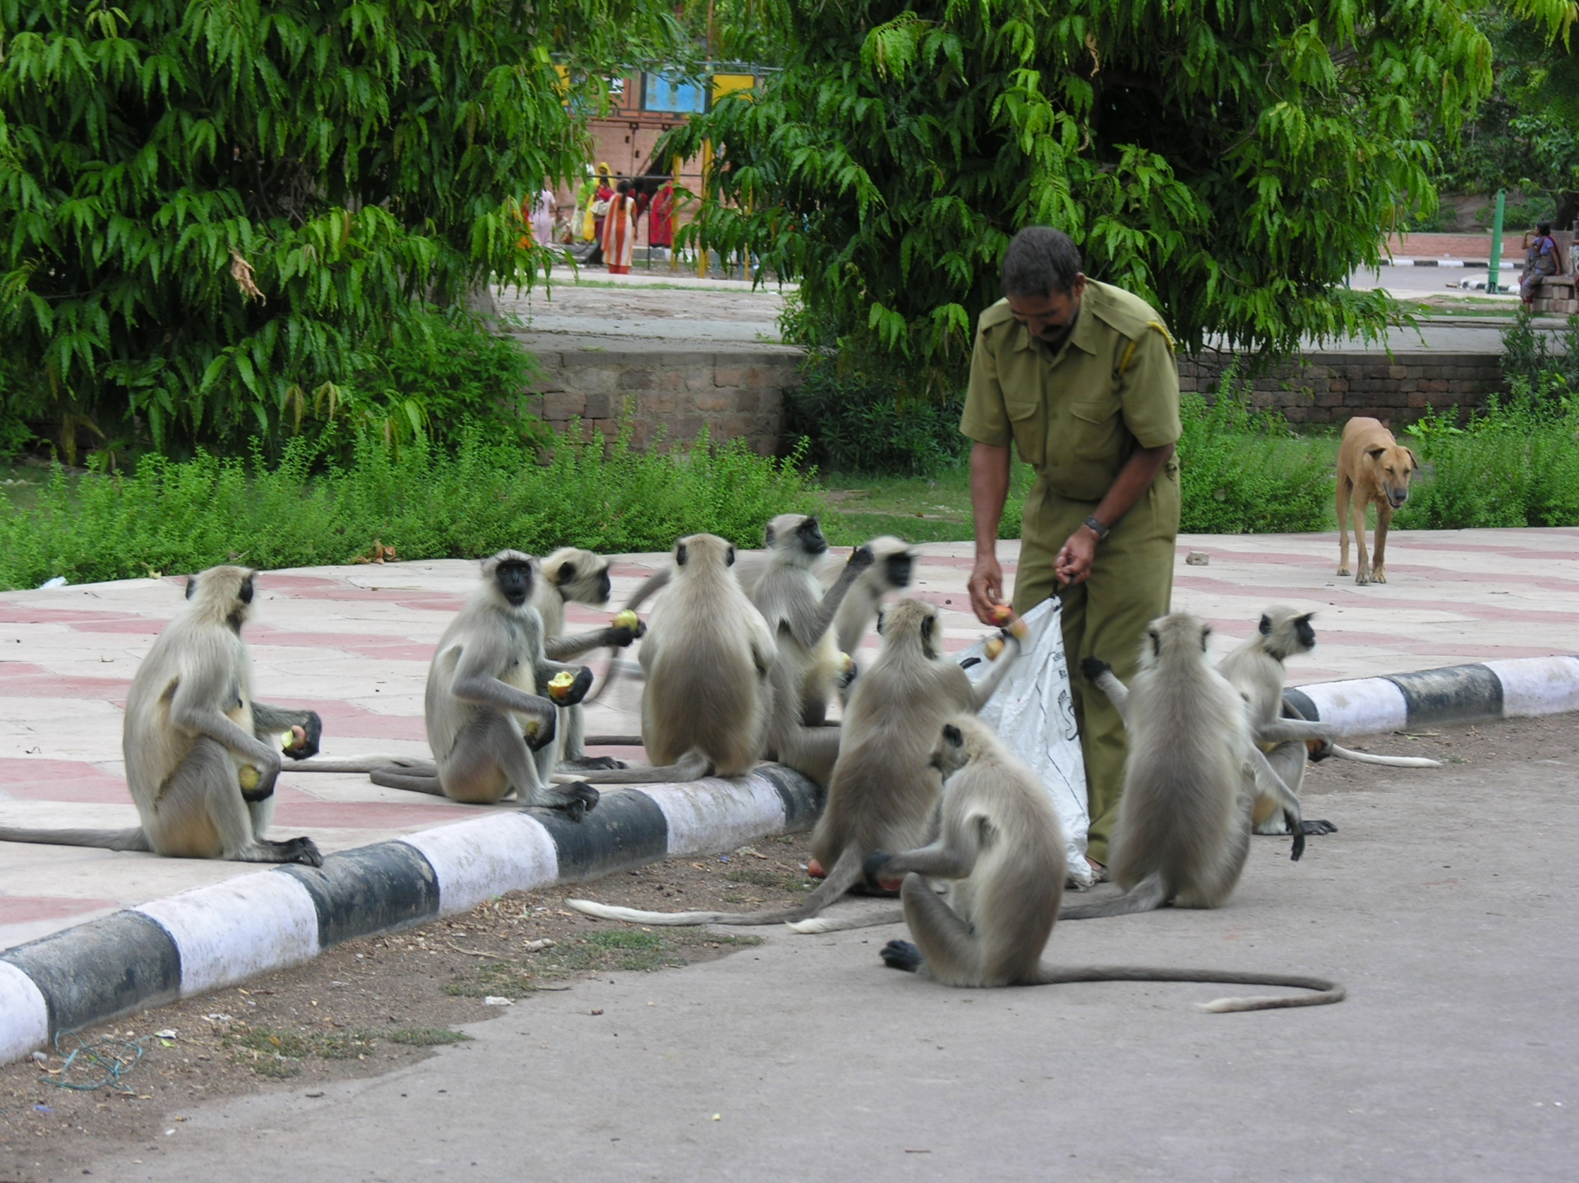
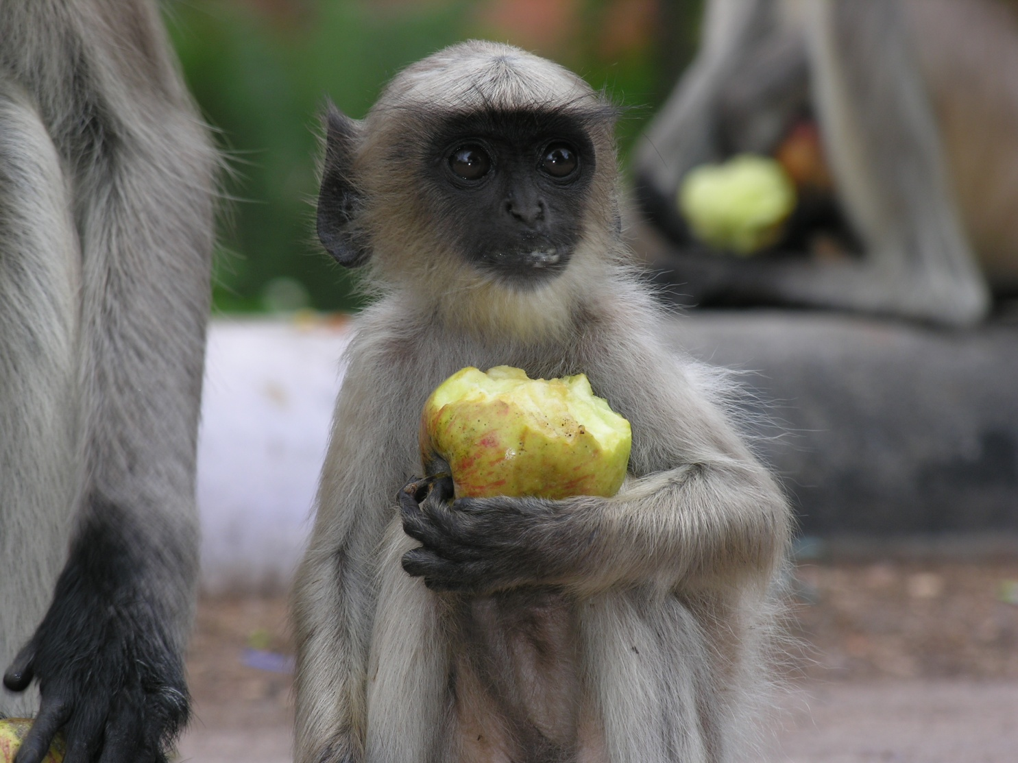
The Dominant Male ? ? ? ?

Slide 16
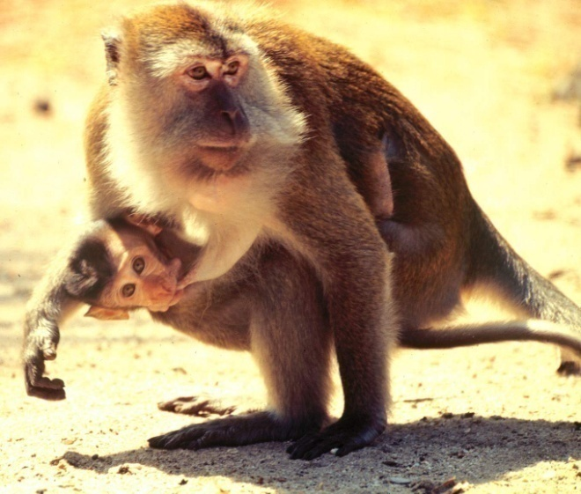
Dominance
Dominance is dynamic not static
Once dominance relationships have been established in a group, the level of aggression tends to decrease.
Few hierarchies are linear A-B-C-D-etc.
they may be circular
Offspring assume maternal rank
Females can have dominance hierarchies
There can be group dominance hierarchy

Slide 17
Misconceptions about Dominance in Primates
Dominance is based on size and strength
Dominant animal is most aggressive
Dominance rankings are permanent
Dominance is a personal attribute
Dominance can be inherited
Dominance hierarchies are confined to males

